Slide 1

Programming in 4GL (DIT 100)
Unit 1.0: Introduction
Presented by Jacob Chikwanda

Slide 2

Goal of this course
Learn the fundamentals of database programming and management using SQL which is a fourth generation programming language (4GL) - a human like language.
Shani

Slide 3
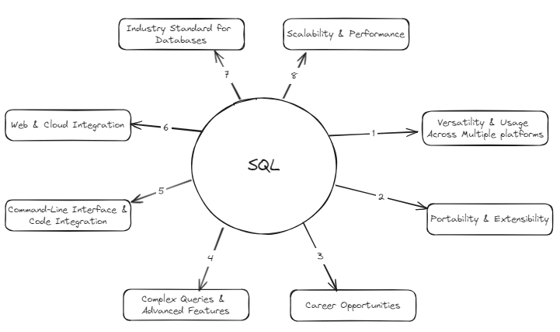
Why learn SQL when they are so many tools out there like - Microsoft Access?

Slide 4
Good Day!

